Slide 1

[Samsung PRISM] Preliminary Discussion
Comparative Analysis –
3D NeRF Asset Generation Models
Team
College Professor(s): Prof. Sunil / --@cambridge.edu.in
Students:
Ramprasad Bharadwaj S N / ramprasad.21ise@cambridge.edu.in / ISE
D Manoj / manoj.21aiml@cambridge.edu.in / AIML
Ranjitha C / ranjitha.21aiml@cambridge.edu.in / AIML
Hemanth Raj M / hemanth.21cse@cambridge.edu.in / CSE
Thanushree N / thanushree@cambridge.edu.in / CSE
Date: 5 DEC 2023

Slide 2


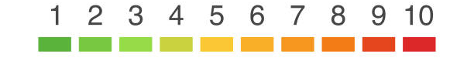

Comparative Analysis – 3D NeRF Asset Generation Models
Problem Statement
Expectations
Context
Undertaken Tasks
Conduct Literature survey.
Compare latest 3D generation models which create the NeRF assets.
Identify next research paradigms.
Generative models have good capabilities on text and image generations. The next frontier for Generative AI is to generate 3D images/models which can be used for Games development and Computer vision applications.
There are many new models which are showing promising results in the 3D generation from few/single images. These models develop NeRF assets by leveraging transformer and diffusion architecture.
KPI
Whitepaper/Journal publication summarizing the overall trends and developments in 3D Generative models.
As a part two of this worklet, based on the outcome of the research, we can extend the worklet to develop a PoC to fine-tune the existing models or improve the existing model’s SOTA.
Statement
Research and literature survey on 3D NeRF Asset Generation Models.
Worklet Details
Mentors
Pranal Prasad Dongare
+91-7022250561
pranal.p@samsung.com
3
3
Timeline
Ranjini Iyer
+91-9901779748
ranjani.iyer@samsung.com
Kick Off < 1st Month >
Milestone 1 < 1st Month >
Milestone 2 < 3rd Month>
Duration (Months)
Members Count
Survey start
Boundary identification
Feasibility study
Checkpoint.
First draft of whitepaper/journal paper.
Final draft.
Pre-Requisite
arXiv:2311.07885v1
https://github.com/openai/shap-e
Adobe Instand3D
arXiv:2310.17075v2 [cs.CV] -> Hyperfields paper
Complexity
Notes:
https://nv-tlabs.github.io/DIB-R/

Slide 3
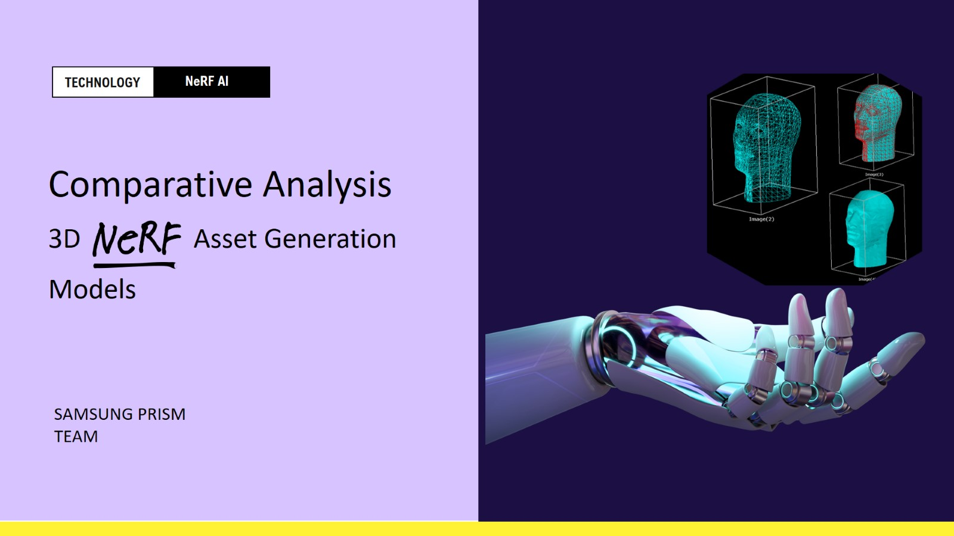

Slide 4
COMPARISION OF DIFFERENT MODELS
SHAP-E (-text to 3d render)
DREAMFUSION
INSTANT – NGP (-image to 3d render)
APPLICATION
BLUEPRINT OF THE APPLICATION
WHITEPAPER
OVERVIEW

Slide 5
Shap-e
Batch size = 4
Size = 64
Time consumed = 110 sec
Renders:

Slide 6
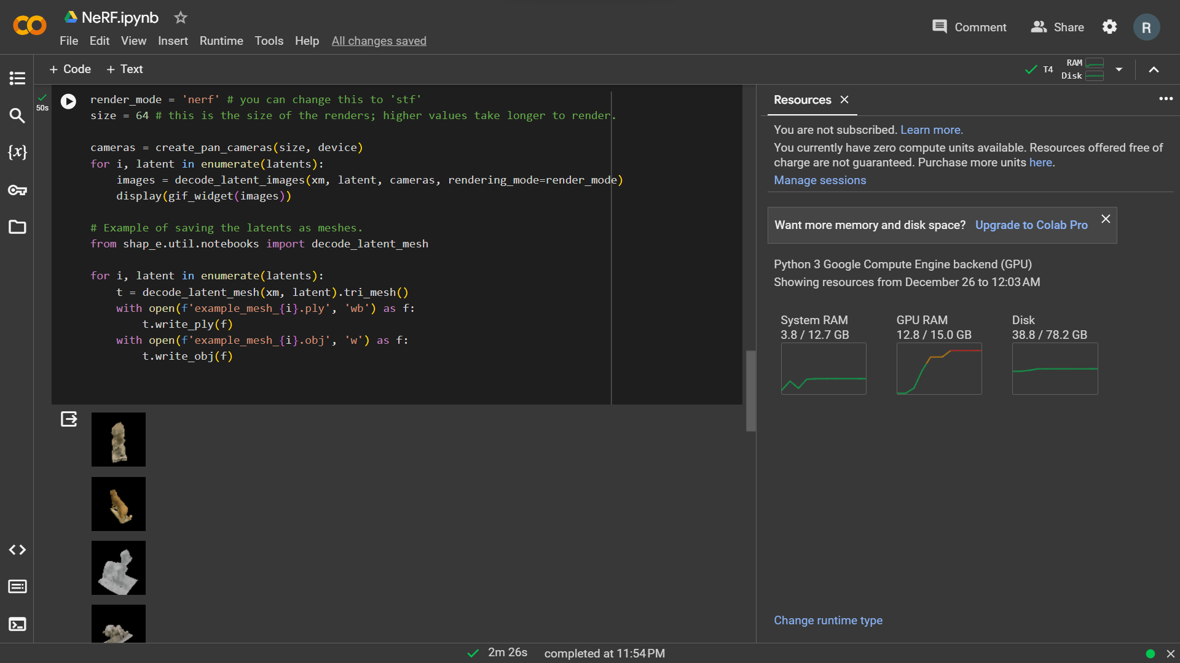

Slide 7
Shap-e
Batch size = 1
Size = 256
Time consumed = 2min 28 sec

Slide 8
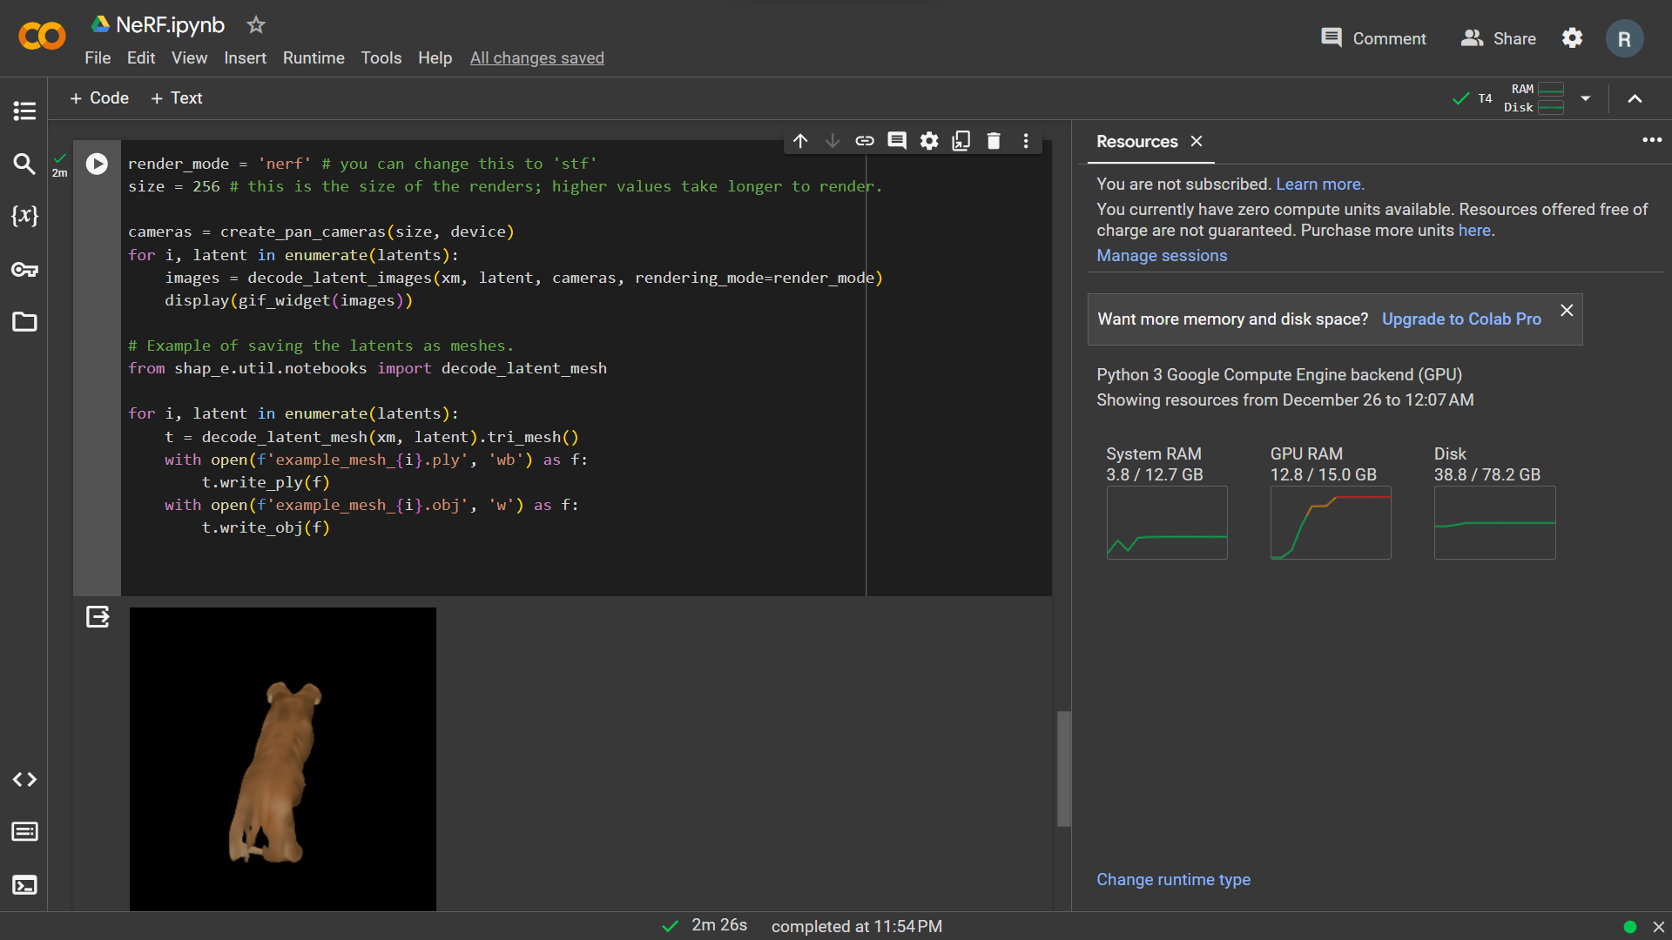

Slide 9
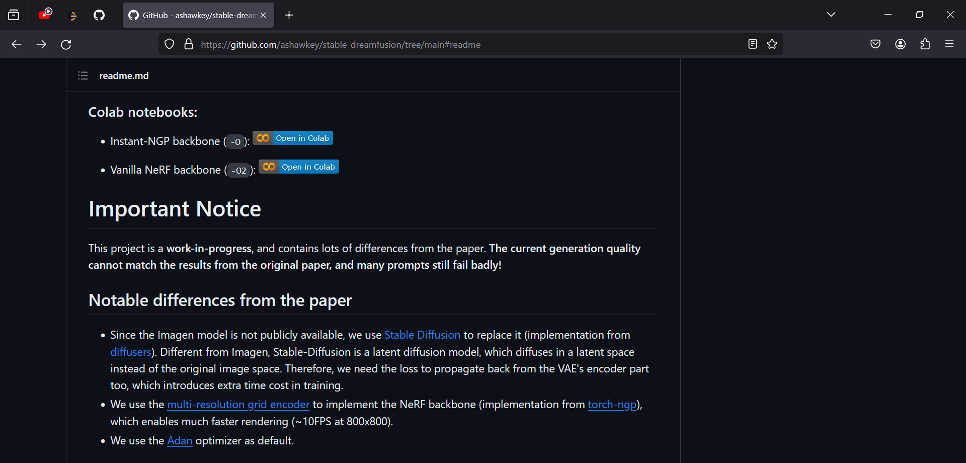
DREAMFUSION – is under maintenance

Slide 10
Instant - NGP
Steps to render:
Capture video
Convert video to images ( by setting fps rate )
Calculate camera angle in each image frame
Render the 3d model

Slide 11
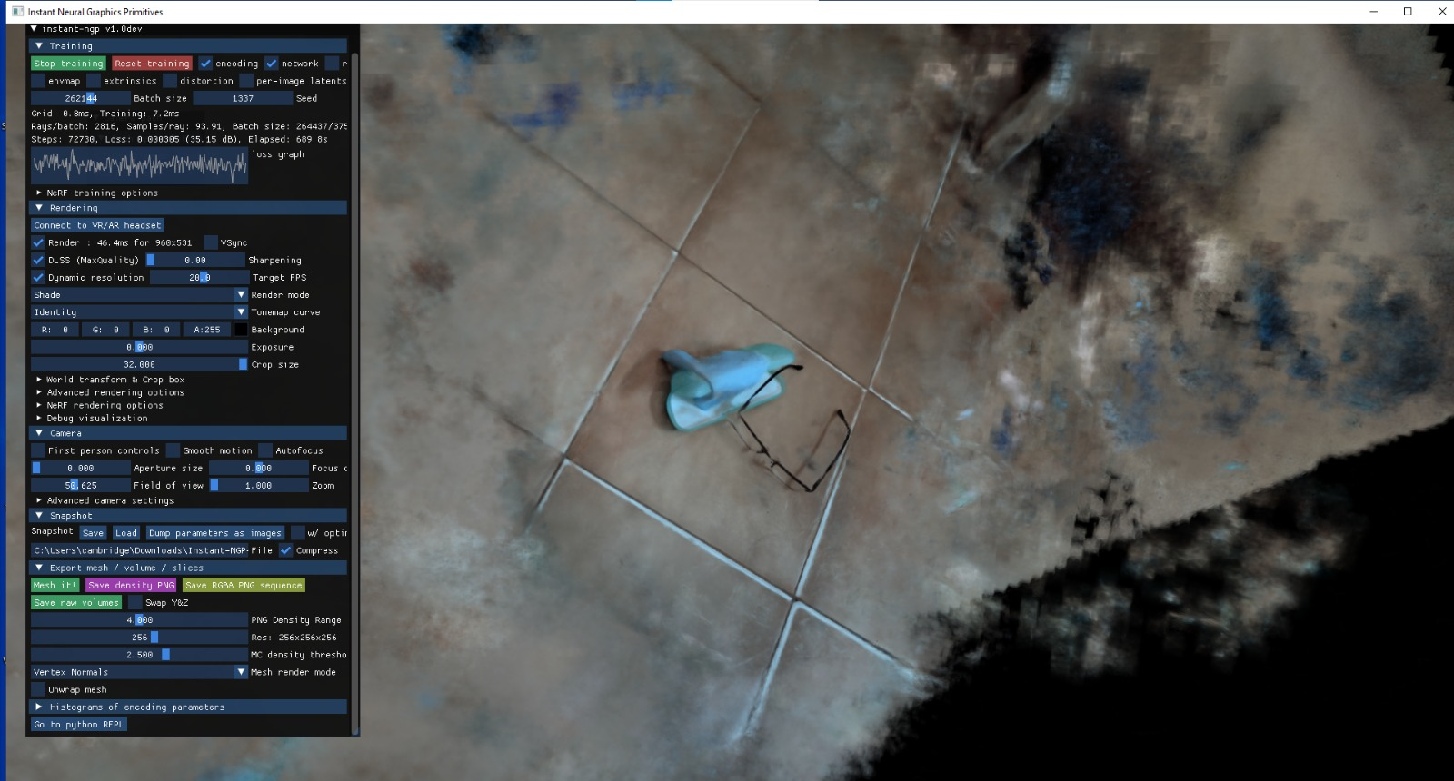
Instant – NGP
-Rendered 3d models (screen shots)

Slide 12
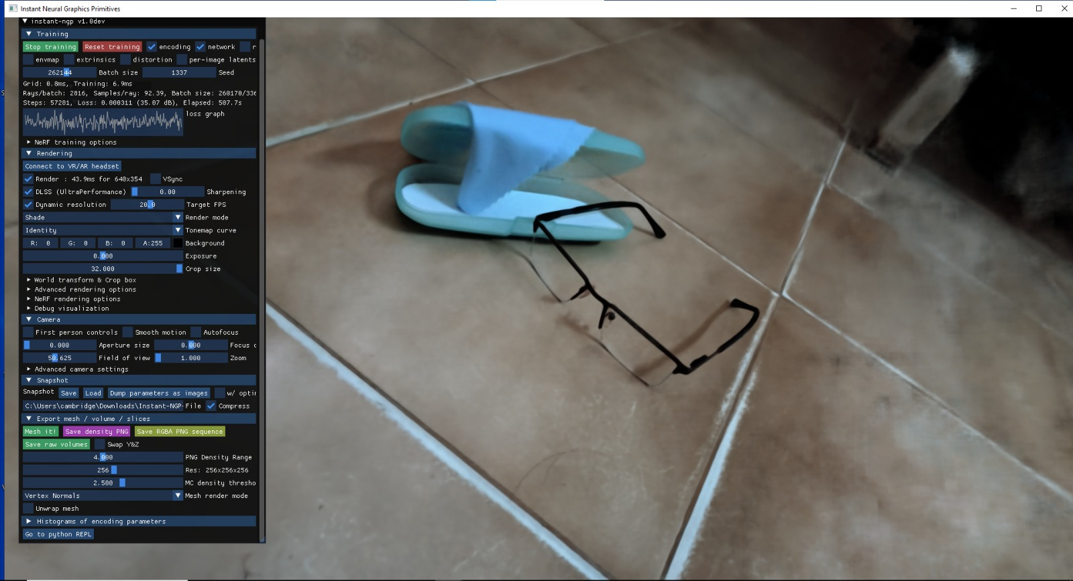
Instant – NGP
-Rendered 3d models (screen shots)

Slide 13
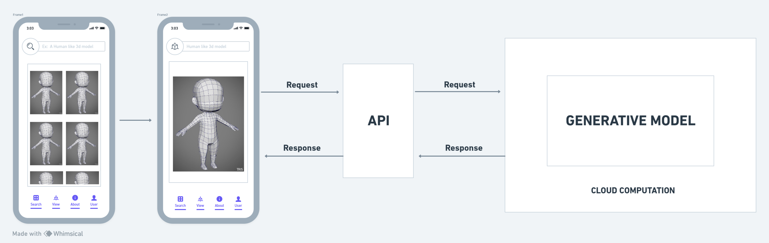
Application – (AN INITIATIVE IDEA)
Blueprint

Slide 14
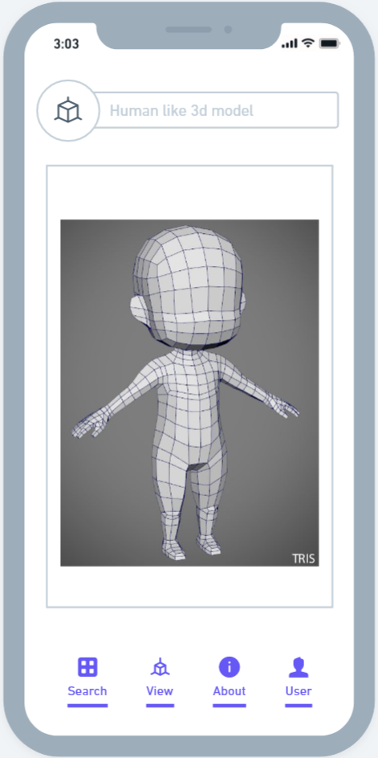
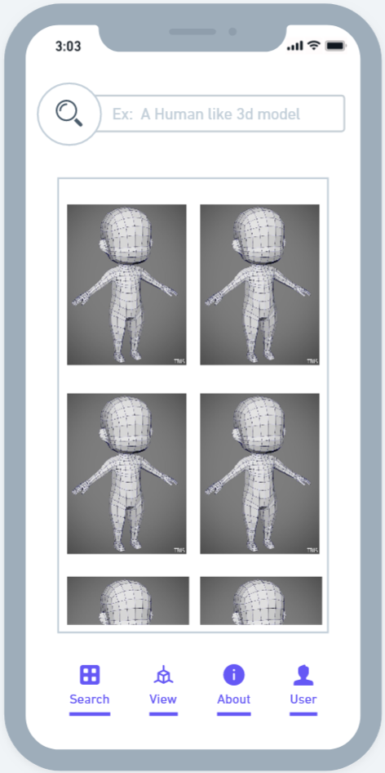
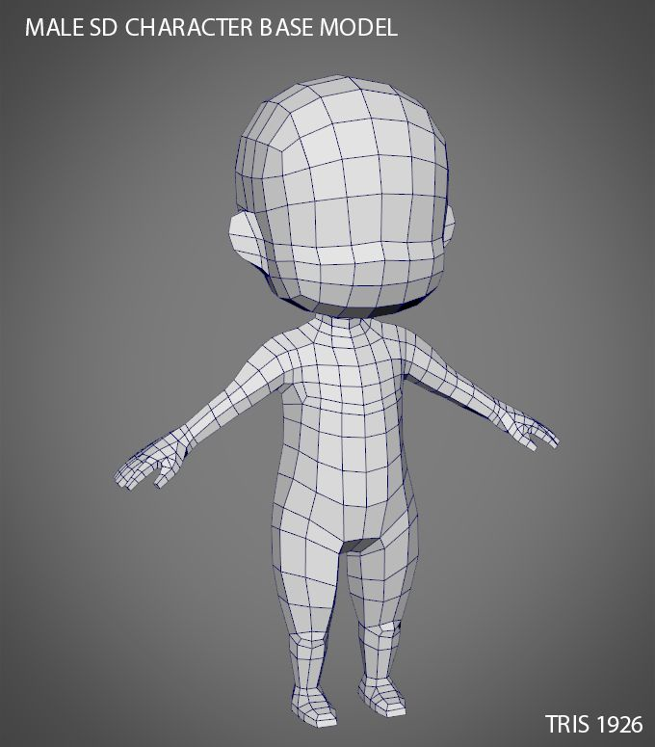

Slide 15
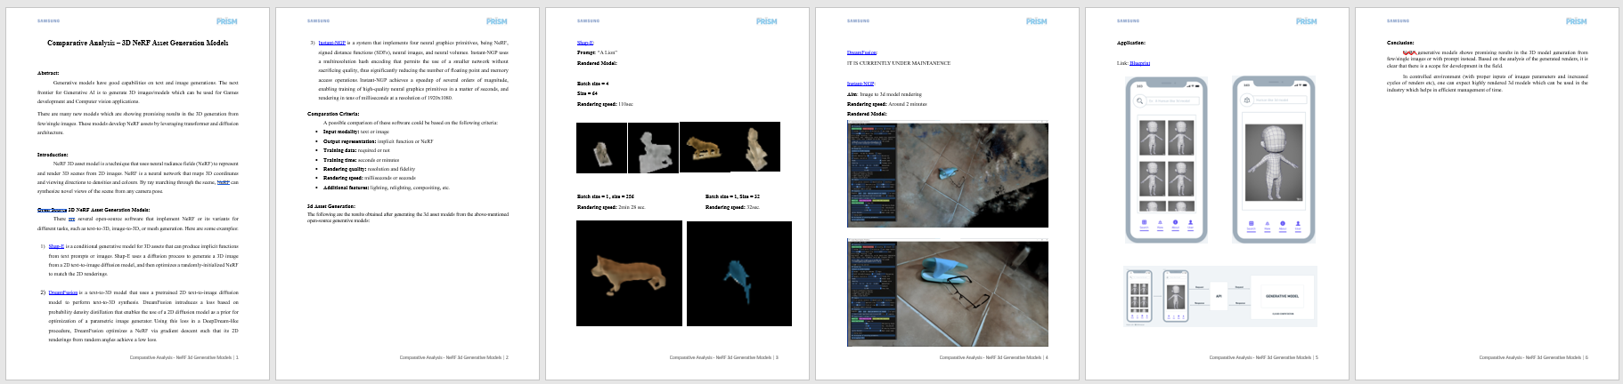
Whitepaper
A document which explains briefly about the models along under sections.

Slide 16
Thank you

